Slide 2
STABILITY CONCEPT- INTRO

Slide 3
Concept of Stability
A system is said to be stable if it does not exhibit large changes in its output for a small change in its input, initial conditions or its system parameters.
In a stable system, the output is predictable and finite for a given input.
The definition of stability depends on the type of system.
Generally, the stability of a system is classified as stable, unstable and marginally stable.
A linear time-invariant(LTIV) system is said to be stable if the output remains bounded when the system is excited by a bounded input. This is called the Bounded-Input Bounded-Output (BIBO) stability criterion.

Slide 4
Concept of Stability
Further, When there is no input, the system should produce a zero output irrespective of initial conditions. This is called the asymptotic stability criterion.
If a bounded input is applied, the system remains stable for all values of system parameters. This is called the absolute stability.
The stability of a system that exists for a particular range of parameters is called conditional stability.
The relative stability indicates how close the system is to instability.
Limitedly stable system produces output that has constant amplitude of oscillations.

Slide 5
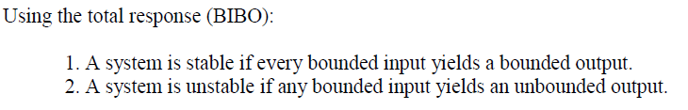
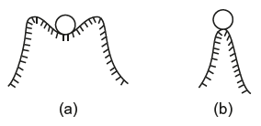


Slide 6
Stable System:
A system is said to be stable if it maintains its equilibrium position (original position) when a small disturbance is applied to it.

Slide 7
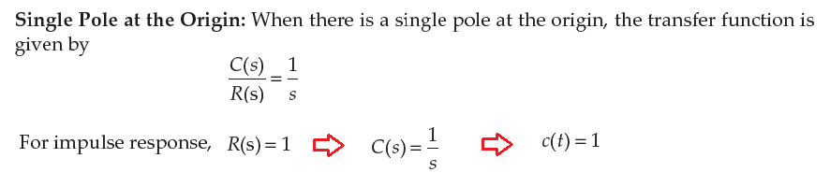
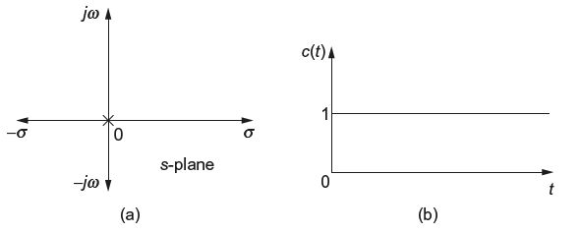
Effects of Location of Poles on Stability

Slide 8
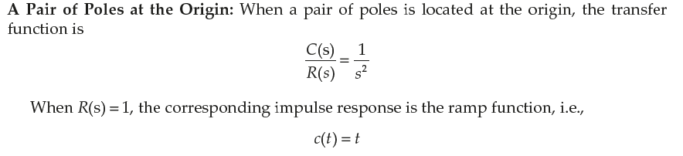
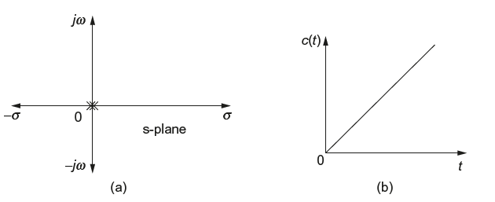
Effects of Location of Poles on Stability

Slide 9
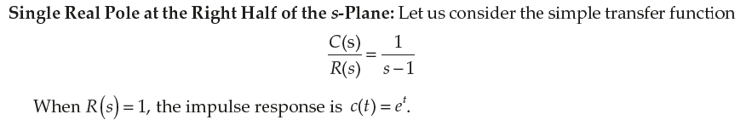
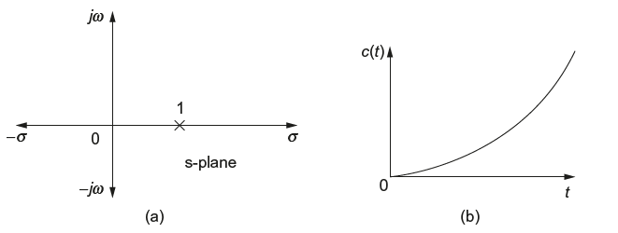
Effects of Location of Poles on Stability
Unstable

Slide 10
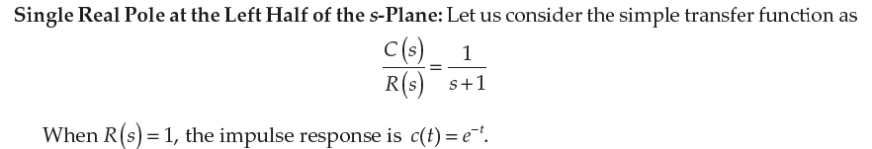
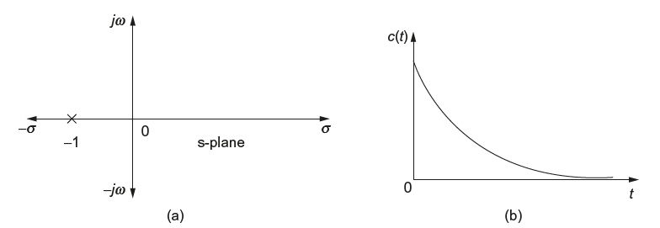
Effects of Location of Poles on Stability
Stable

Slide 11
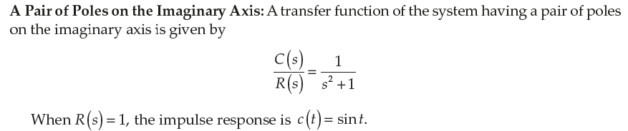
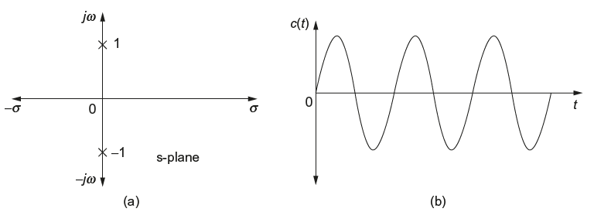
Effects of Location of Poles on Stability
MarginallyStable; Oscillatory

Slide 12
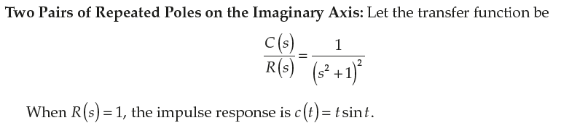
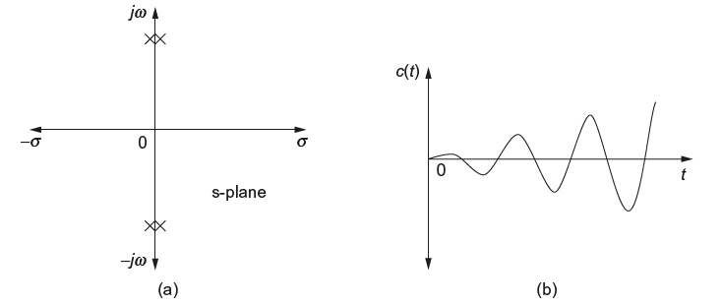
Effects of Location of Poles on Stability
Unstable

Slide 13
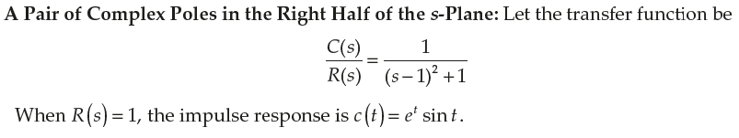
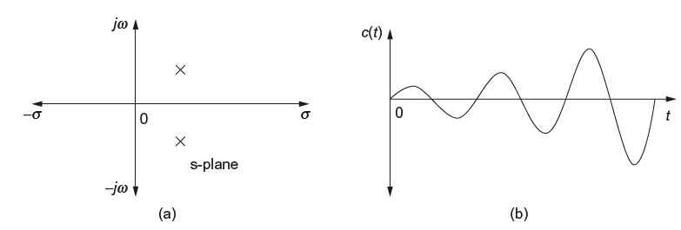
Effects of Location of Poles on Stability
Unstable

Slide 14
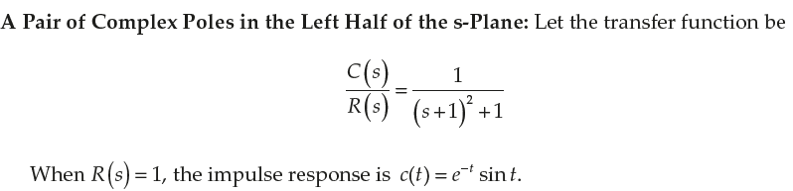
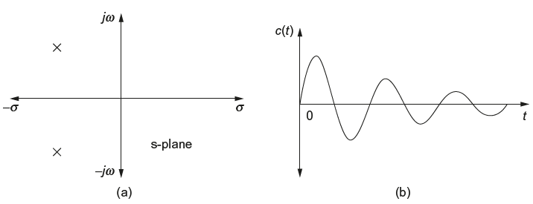
Effects of Location of Poles on Stability
Stable

Slide 15
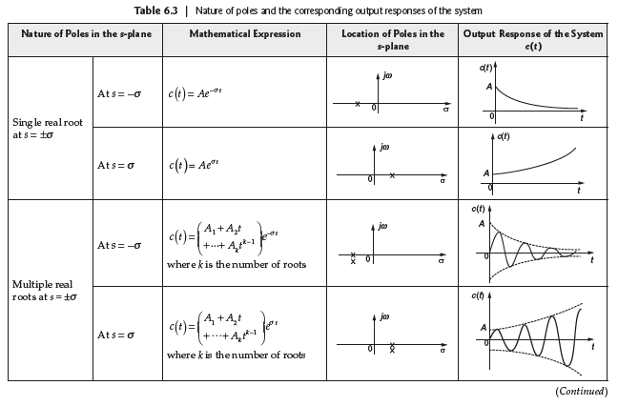
Effects of Location of Poles on Stability

Slide 16
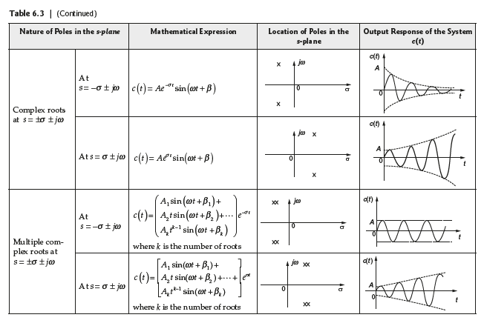
Effects of Location of Poles on Stability

Slide 17
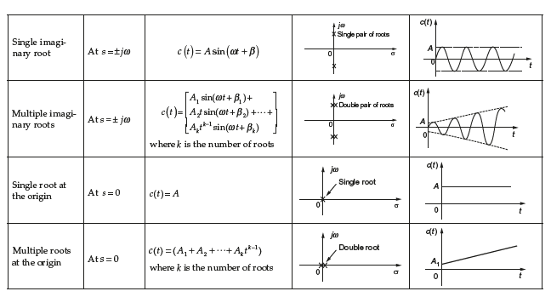
Effects of Location of Poles on Stability

Slide 18
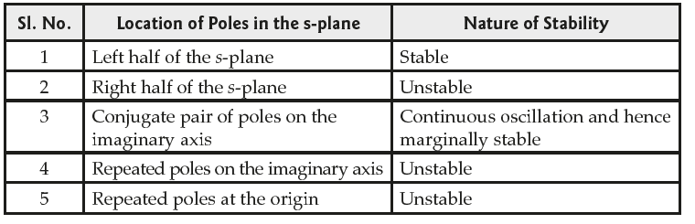
Effects of Location of Poles on Stability

Slide 19
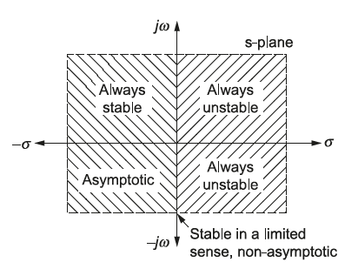
Effects of Location of Poles on Stability

Slide 20
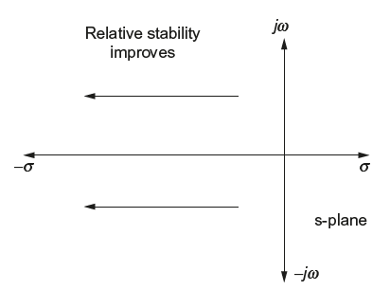
Relative Stability
For a system, the relative stability improves as the closed-loop poles of the transfer function moves away from the imaginary axis in the left half of the s-plane as shown in Fig.

Slide 21

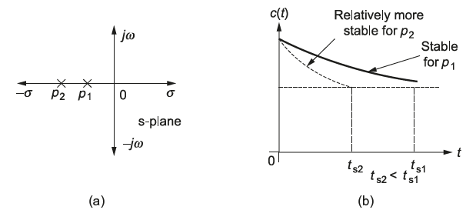
Relative Stability

Slide 22
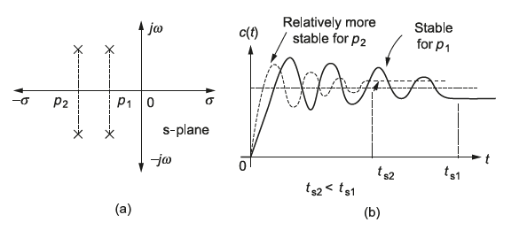
Relative Stability

Slide 23
Routh–Hurwitz criterion

Slide 24
Routh–Hurwitz criterion
Routh–Hurwitz criterion, method helps in determining the number of closed-loop system poles in the left half of the s-plane, the right half of the s-plane and on the jw axis, but not their co-ordinates.
Stability of the system can be determined by the location of poles.
This method of examining the stability criterion of the system is known as Routh’s array method or Routh–Hurwitz method.
In this method, the coefficient of the characteristic equation of the system are tabulated or framed in a particular way.
The array formed by tabulating the coefficients of the characteristic equation is called Routh’s array.

Slide 25
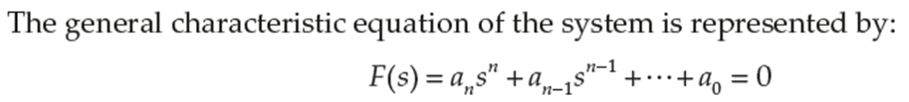

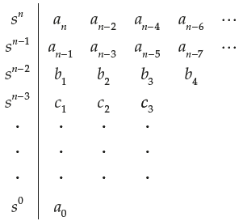

Routh Array Construction

Slide 26

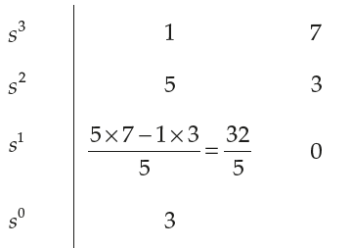
Problems in Routh Stability Criterion

Slide 27
Problems in Routh Stability Criterion

Slide 28
Problems in Routh Stability Criterion
Stable System

Slide 29



Problems in Routh Stability Criterion

Slide 30
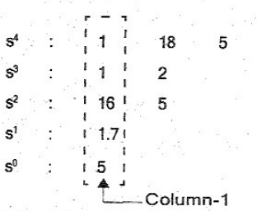
Problems in Routh Stability Criterion

Slide 31
Problems in Routh Stability Criterion

Slide 32
Problems in Routh Stability Criterion

Slide 33
Problems in Routh Stability Criterion

Slide 34
Problems in Routh Stability Criterion
Stable System

Slide 35

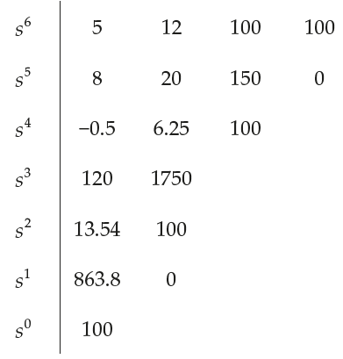
Problems in Routh Stability Criterion

Slide 36
Problems in Routh Stability Criterion

Slide 37
Problems in Routh Stability Criterion

Slide 38
Problems in Routh Stability Criterion

Slide 39
Problems in Routh Stability Criterion

Slide 40
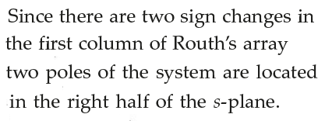

Problems in Routh Stability Criterion
Unstable System

Slide 41
Thank you

